Slide 1
Recurrence Relation
+
Substitution Method
Analysis of Algorithms
Mariha Asad

Slide 2
Recurrence Relation (Example 1)
void Test(int n) T(n)
{
if(n>0) 1
{
cout << n; 1
Test(n-1); T(n-1)
Test(n-1); T(n-1)
}
}

Slide 3
Solving Recurrence Relation (Example 1)
Using Substitution Method
T(n) = 2T(n-1) + 1 when n>0 eq 1
T(0) = 1 when n =0 (for base case)
Substituting T(n-1) in eq 1
T(n) = 2 [2T(n-2) + 1] + 1
T(n) = 2² T(n-2) + 2 + 1 eq 2
Substituting T(n-2) in eq 2
T(n) = 2²[2 T(n-3) + 1] + 2 + 1
T(n) = 2³ T(n-3) + 2² + 2 + 1 eq 3
Continues for k times it will become
T(n) = 2^{k} T(n-k) + 2^{k-1} + … + 2² + 2 + 1
Assume n-k = 0 :. n=k
T(n) = 2^{n} T(n-n) + 2^{n-1} + 2^{n-2} … + 2² + 2 + 1
T(n) = 2^{n} T(0) + 2^{n-1} + 2^{n-2} … + 2² + 2¹ + 2⁰
T(n) = 2^{n} X 1 + 2^{n} - 1
T(n) = 2^{n} + 2^{n} - 1 = (2 X 2^{n} -1) It becomes T(n) = 2^{n+1} – 1 so it is O(2^{n})
T(n) = 2T(n-1) + 1
T(n-1) = 2 T(n-1-1) + 1
T(n-1) = 2T(n-2) + 1
T(n-2) = 2 T(n-2 -1) + 1
T(n-2) = 2 T(n-3) + 1

Slide 4
Recurrence Relation (Example 2)
Void Test(int n) T(n)
{
if(n>1) 1
{
cout << n; 1
Test(n/2); T(n/2)
}
}

Slide 5
Solving Recurrence Relation (Example 2)
Using Substitution Method
T(n) = T(n/2) + 1 when n>1 eq 1
T(1) = 1 when n=1 (for base case)
Substituting T(n/2) in eq 1
T(n) = [ T(n/2²) + 1] + 1
T(n) = T(n/ 2²) + 2 eq 2
Substituting T(n/ 2²) in eq 2
T(n) = T(n/ 2³) + 3 eq 3
T(n) = T(n/ 2^{k}) + k eq 4
Assume n/ 2^{k} = 1 ➔ n= 2^{k} ➔ k = logn
T(n) = T(1) + logn
T(n) = 1 + logn so it is O(logn)
T(n) = T(n/2) + 1
T(n/2²) = T(n/2² /2) + 1
n= 2^{k}
Log n = log 2^{k}
^{Logn = k log 2}
^{K = log n}

Slide 6
Solving Recurrence Relation (Example 3)
Using Substitution Method
T(n) = T(n/2) + n eq 1
T(1) = 1
T(n) = [T(n/ 2²) + n/2 ] + n
T(n) = T(n/2²) + n/2 + n eq 2
T(n) = [T(n/ 2³) + n/ 2²] + n/2 + n
T(n) = T(n/ 2³) + n/ 2² + n/2 + n eq 3
T(n) = T(n/ 2^{k}) + n/ 2^{k-1} + n/ 2^{k-2} + n/ 2² + n/2 + n eq 4
Assume n/ 2^{k} = 1 ➔ n = 2^{k} ➔ k = logn
T(n) = T(1) + n/ 2^{k-1} + n/ 2^{k-2} + n/ 2² + n/2 + n
T(n) = T(1) + n [ 1/ 2^{k-1} + 1/ 2^{k-2} + 1/ 2² + 1/2 + 1 ]
T(n) = 1 + n[ 1 + 1]
T(n) = 1 + 2n so it is O(n)

Slide 7
Helping Slide for Students
Geometric Progression
ar⁰ + ar¹ + ar² + ar³ + …+ ar^{k} = a (r^{k+1} - 1)/r-1
2⁰ + 2¹ + 2² +… 2^{k} = ?
a = 1, r=2 , k= n-1
1(2^{n-1+1} - 1)/2-1 = 2^{n} -1

Slide 8

Helping Slide for Students
$\sum_{i=0}^{k}{\text{1/2}\text{i}}$ = 1

Slide 9
Quiz and Assignment
Recurrence relation of a code
Solving recurrence relation using substitution method
From Lecture 1 and 2

Slide 10
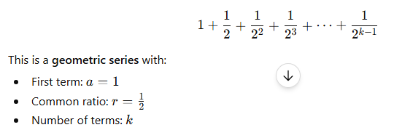
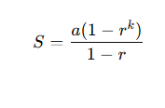
Helping

Slide 11
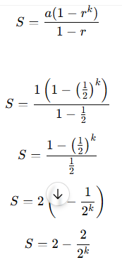
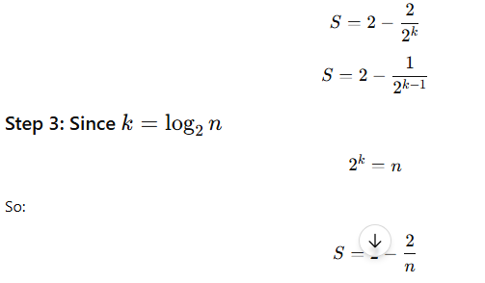
Helping

Slide 12
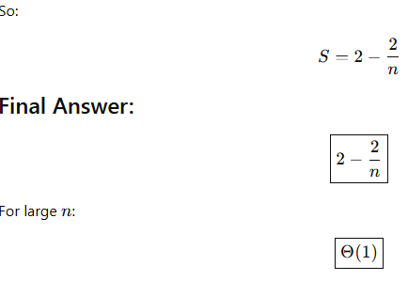
Helping

Slide 13
Thanks

